Slide 1
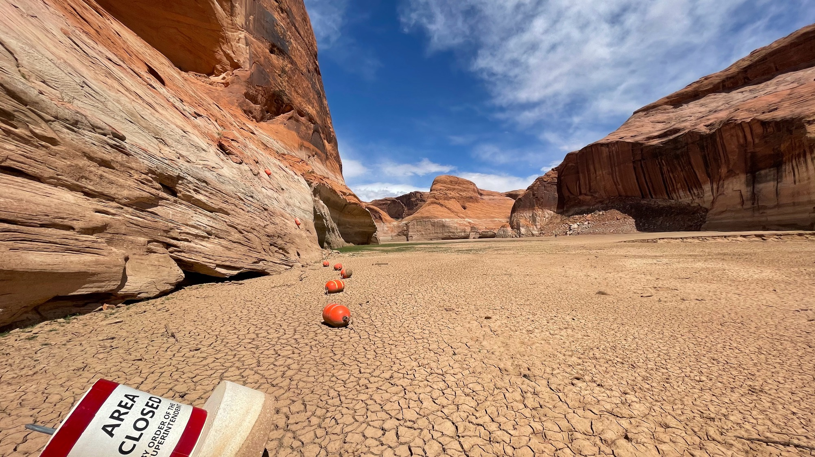
Utah’s Climate Future
Seth Arens
Western Water Assessment
University of Utah
6/30/21
Escalante Arm of Lake Powell
April 15, 2021

Slide 2
Climate is already changing in Utah
Utah warmed 2.6°F since 1895
U.S. warmed 1.8 °F
since 1895
Eastern and southern UT
warmed by 4-5°F
Data source: NOAA NCEI Climate at a Glance

Slide 3
…And it’s going to get hotter
2065
RCP4.5 → +4.5°F
RCP8.5 → +6.7 °F
2090
RCP4.5 → +6.7°F
RCP8.5 → +9.8 °F
Data source: USGS National Climate Change Viewer

Slide 4
…And precipitation will increase (maybe)
Not all models agree
20% of models
project decrease
20% project a significant increase
2065
RCP4.5 → +5.8%
RCP8.5 → +8.3%
2090
RCP4.5 → +8.3%
RCP8.5 → +10.7%
Data source: USGS National Climate Change Viewer

Slide 5
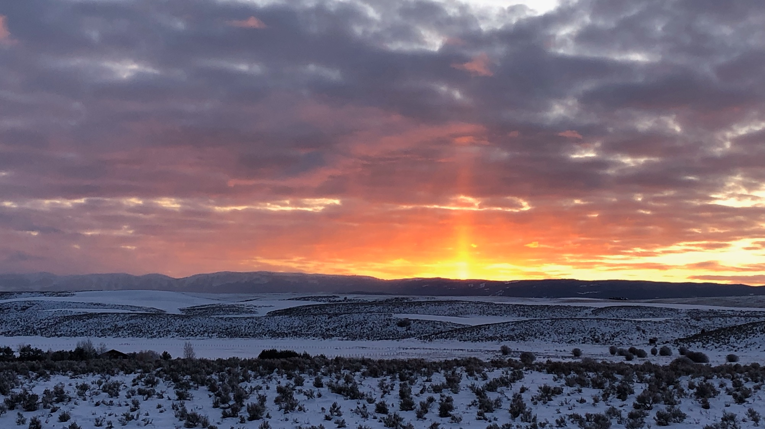
…But it will snow less
40% decrease in snow by 2040
60 – 85% decrease by 2090
By 2090 (RCP8.5), more than 90% decrease in Box Elder, Grand, Juab, Millard and Tooele Counties
Data source: USGS National Climate Change Viewer

Slide 6
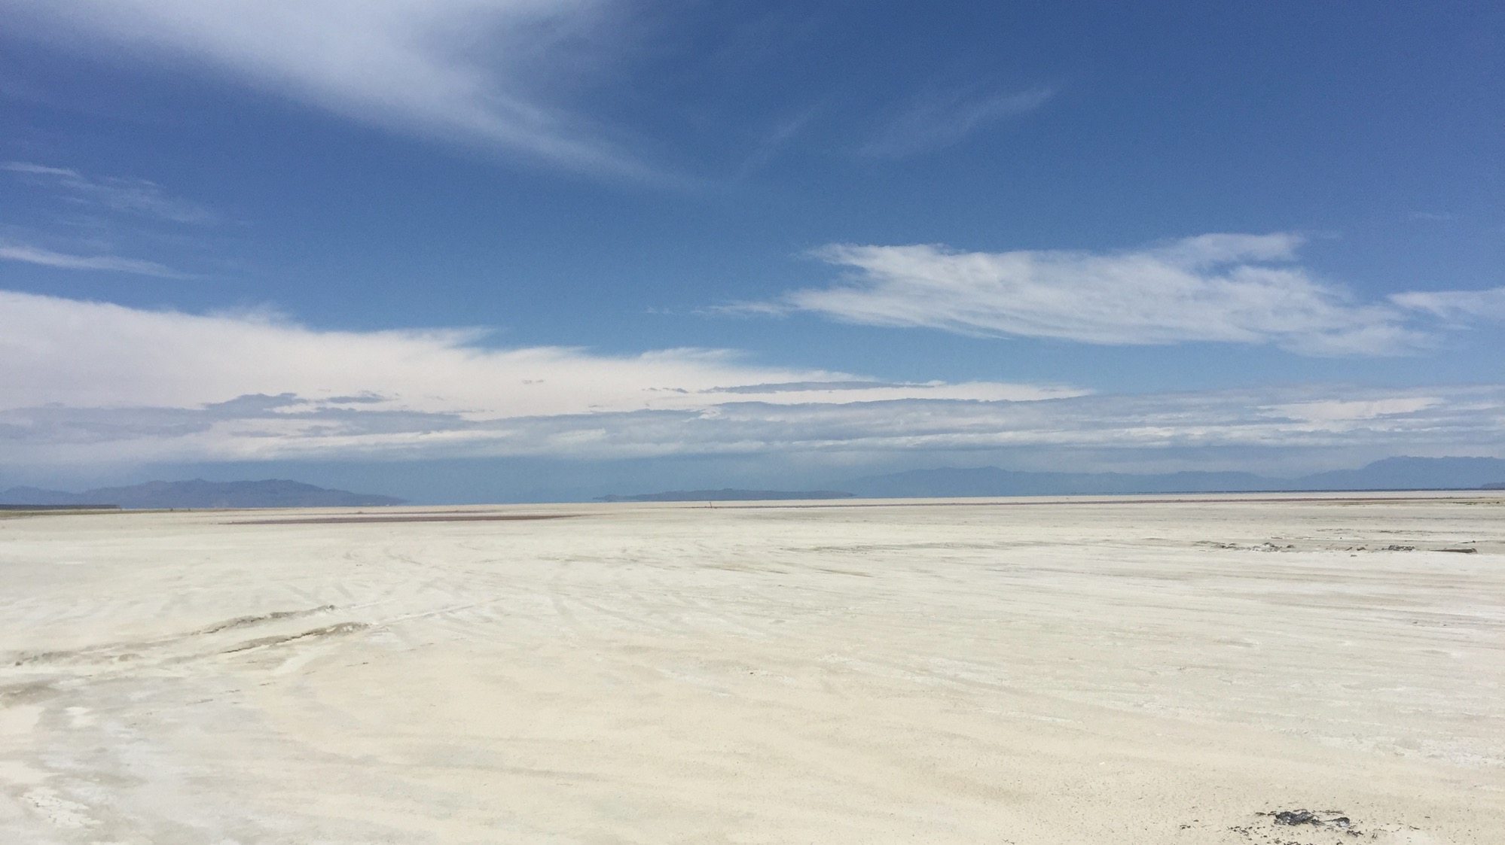
…And it will be drier…Huh?
Higher temperatures drive large increase in evapotranspiration (ET)
  ET is water lost to atmosphere through evaporation and plant transpiration
Increase in ET more than offsets modest increase in precipitation
Less snow and earlier melt also cause drier conditions
Higher temperatures alone will cause more drought
Great Salt Lake near Stansbury Island

Slide 7
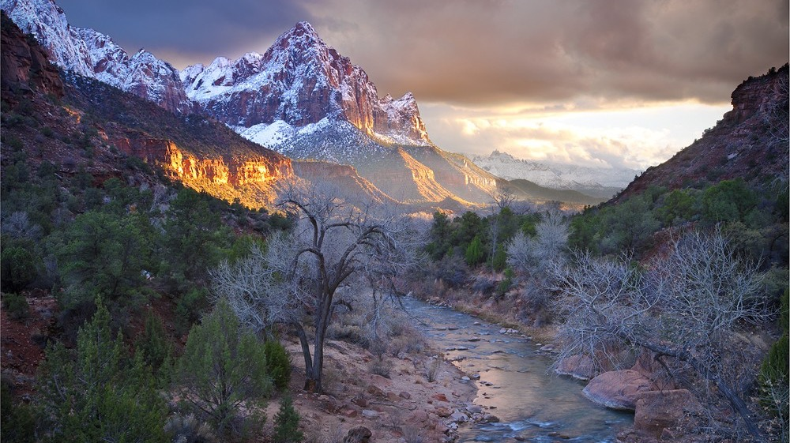
Upper Virgin River water budget – average year
Precipitation
18”
(60% of precip)
30”
Evapotranspiration (ET)
Runoff
12”
Normal runoff
Notes:
7

Slide 8
Projected Upper Virgin River water budget – 2065
Precipitation
22.75”
(70% of precip)
32.5”
By 2090, Utah surface water supply could decrease by 800,000 acre-feet
Represents 34% of surface water used in Utah during 2015
Evapotranspiration (ET)
8.3% more precip
10% increase in ET
Runoff
9.75”
81% of normal runoff
”New normal” runoff
81% of 2021 average runoff
Notes:
8

Slide 9
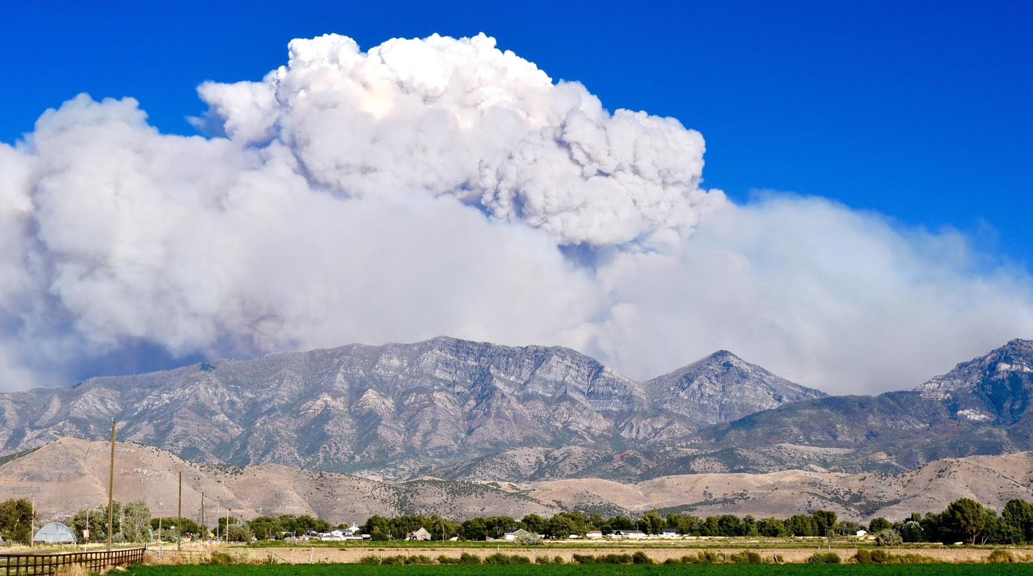
How will climate hazards/natural disaster change?
Drought will increase – frequency, severity, extent
  Average years of past become drought years of future
Extreme heat waves will be more frequent and hotter
Wildfire will increase – greater chance of very large fires
  Drier conditions, longer fire season due to less snow
  Air quality impacts even when no fires in Utah
Increased risk of extreme rainfall and flooding
Compounding hazards
  Climate change and hazards act in concert
  Example: more drought → increased wildfire → increased flash flood risk

Slide 10
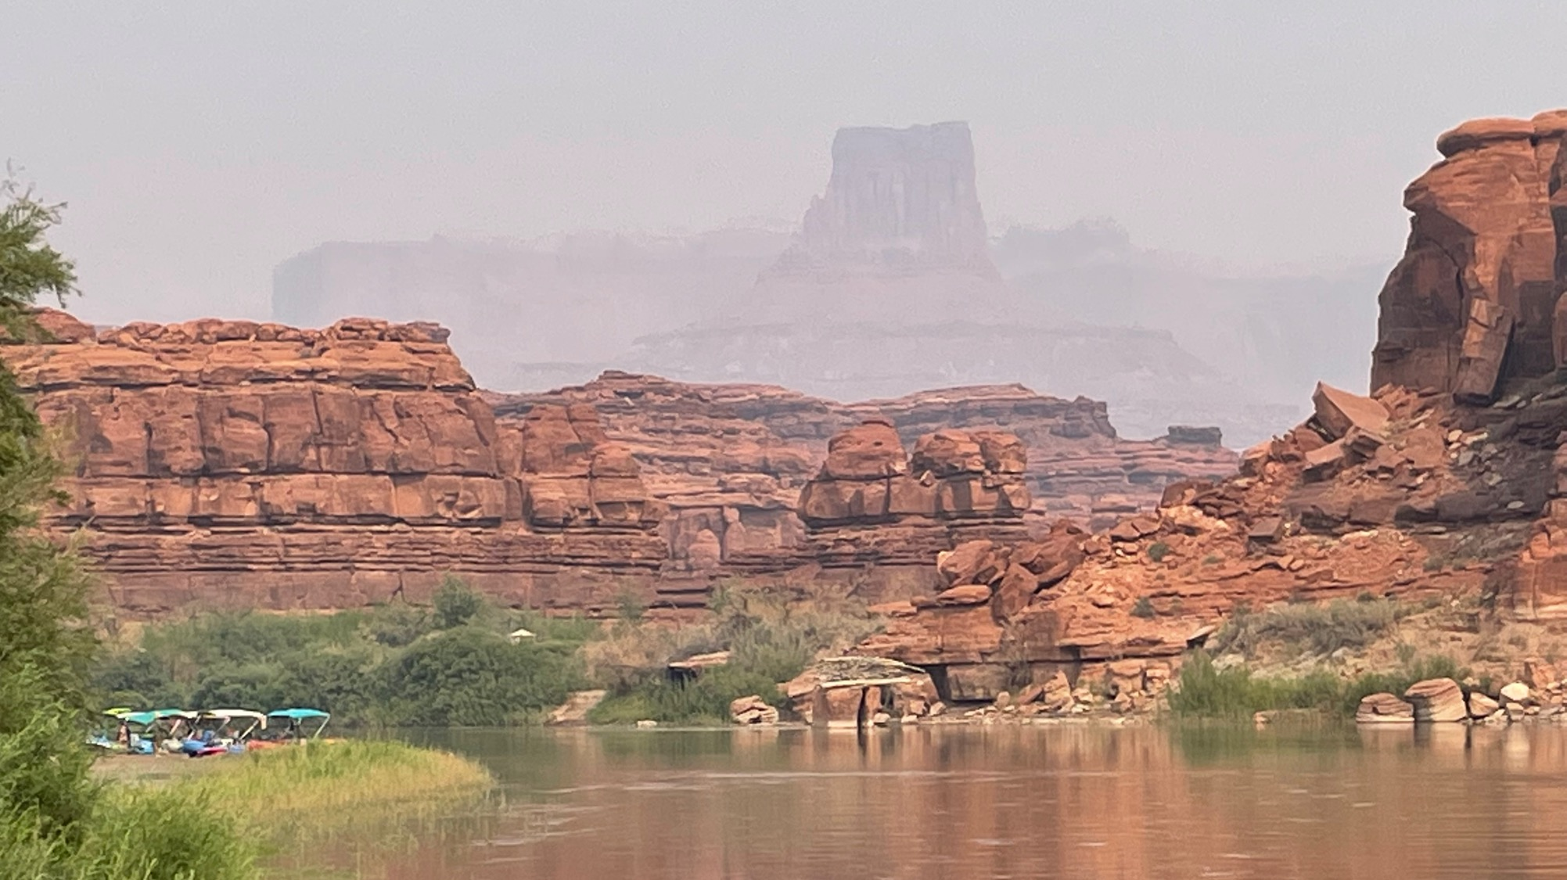
Climate impacts in Utah
Water supply – quantity and quality issues
  Municipal water use
  Agricultural water use and agriculture
Ski industry and tourism – less snow, summer air quality impacts
Quality of life - hotter temperatures and poor air quality in summer
Economic growth – water supply, transportation, air quality
Infrastructure readiness – need to build resiliency
Great Salt Lake – reached all-time low elevation in August
Climate justice – climate change disproportionately affects low-income, Latino and Native American communities
Smoke along the Colorado River in Utah, August 2021

Slide 11
Seth Arens
Research scientist
Western Water Assessment
wwa.arens@gmail.com

